Slide 1
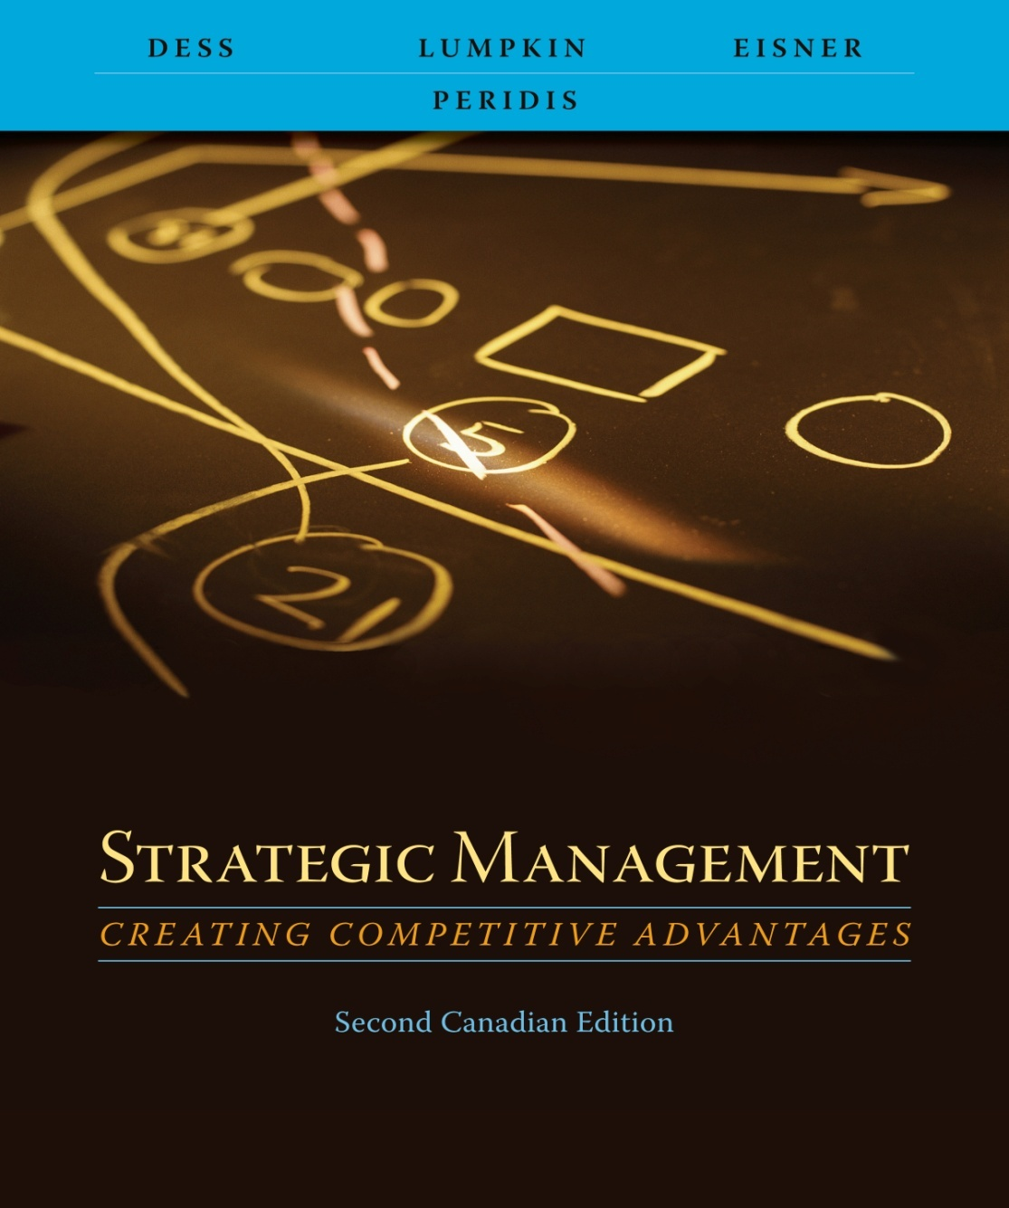
Chapter 4
Recognizing A Firm’s
Intellectual Assets

Slide 2
Learning Objectives
After reading this chapter, you should have a good understanding of:
  The increasing value of intellectual assets for today’s corporations and for the prosperity of a country.
  Why the management of knowledge and knowledge professionals is so critical in today’s organizations.
  The importance of recognizing the interdependence between attracting, developing, and retaining human capital.

Slide 3
Learning Objectives
After reading this chapter, you should have a good understanding of:
  4. The key role of social capital in leveraging human capital within and across an organization.
  5. The vital role of technology in leveraging knowledge and human capital.
  6. How protecting intellectual property is central to sustainable competitive advantage.

Slide 4
The Central Role of Knowledge in Today’s Economy
Creation of wealth in a knowledge economy
  Effective management of knowledge workers
  Intellectual capital
  Assets such as
    Reputation
    Employee loyalty and commitment
    Customer relationships
    Company values
    Brand names
    Experience and skills of employees

Slide 5
The Central Role of Knowledge in Today’s Economy
Intellectual capital = Market value of the firm – Book value of the firm
How do companies create value in the knowledge-intensive economy?
  Human capital (individual capabilities, knowledge, skills, and experience of the company’s employees and managers)
  Social capital (the network of relationships that individuals have throughout the organization)
  Knowledge
    Explicit knowledge
    Tacit knowledge

Slide 6
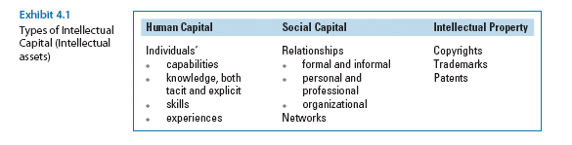

Slide 7
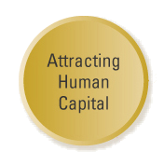
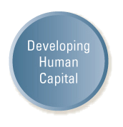
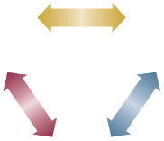
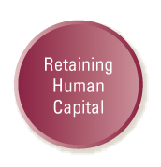
Human Capital:
Three Interdependent Activities
Exhibit 4.2 Human Capital: Three Interdependent Activities

Slide 8
Attracting Human Capital
Hire for attitude, train for skill
Emphasis on
  General knowledge and experience
  Social skills
  Values
  Beliefs
  Attitudes

Slide 9
Attracting Human Capital
Sound recruiting approaches
  Scanning pools of available candidates
  Challenge becomes having the right job candidates, not the greatest number of them
Networking
  Current employees may be best source of new ones
  Incentives for referrals

Slide 10
Developing Human Capital
Train and develop at all levels
  Training is not the sole responsibility of the human resource department
Rapid changes in technology
  Employee skills become obsolete
  Training is cost effective
Monitor progress and track development

Slide 11
Developing Human Capital
Evaluate Human Capital
  Employees must share knowledge and work together, collectively, to reach organizational goals
  Firms often use 360-degree evaluation and feedback systems
  Managers’ success cannot compromise the organization’s core values

Slide 12
360-Degree Leadership Assessment
Has developed and communicated a clear, simple, customer-focused vision/direction for the organization.
Forward-thinking, stretches horizons, challenges imaginations.
Inspires and energizes others to commit to Vision. Captures minds. Leads by example.
As appropriate, updates Vision to reflect constant and accelerating change affecting the business
Performance Criteria of “Vision”
Ten Characteristics of Leadership
Vision
Customer/Quality Focus
Integrity
Accountability/Commitment
Communication/Influence
Shared Ownership/Boundary-less
Team Builder/Empowerment
Knowledge/Expertise/Intellect
Initiative/Speed
Global Mind-Set
Adapted from Exhibit 4.3 An Excerpt from General Electric’s 360-Degree Leadership Assessment Chart
Source: Adapted from R. Slater, Get Better or Get Beaten (Burr Ridge, IL: Irwin Professional Publishing, 1994), pp. 152-155.

Slide 13
Retaining Human Capital
Provide mechanisms that prevent the transfer of valuable and sensitive information outside the organization
  Identify with organization’s mission and values
  Strong alliance to organization (strategic intents)
Challenging work and stimulating environment

Slide 14
Retaining Human Capital
Financial and Non-financial Rewards and Incentives
  Rewards are a vital organizational control mechanism
  However, money may not be the most important reason why people take or leave jobs
  Exodus of employees can erode a firm’s competitive advantage

Slide 15
The Vital Role of Social Capital
Attraction, development and retention of talent is a necessary but not sufficient condition for creating competitive advantage
Knowledge workers often are more loyal to their colleagues and profession than to their employer

Slide 16
How Social Capital Helps
Attract and Retain Talent
Hiring via personal (social) networks
  Some job candidates may bring other talent with them
  Emigration of talent from an organization to form start-up ventures
  Can provide mechanism for obtaining resources and information from outside the organization

Slide 17
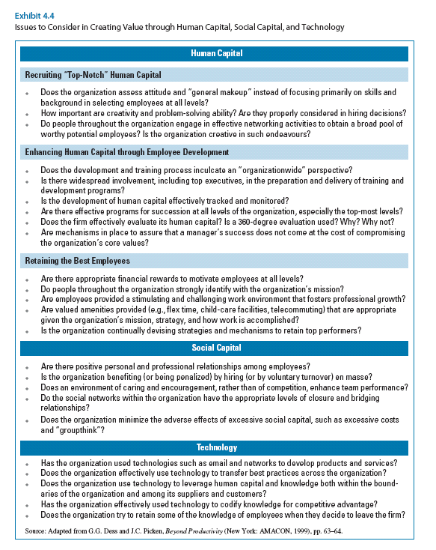

Slide 18
Using Technology to Leverage Human Capital and Knowledge
Sharing knowledge and information
  Conserves resources
  Develops products and services
  Creates new opportunities
Technology can leverage human capital and knowledge
  Within the organization
  With customers
  With suppliers

Slide 19
Using Technology to Leverage Human Capital and Knowledge
Using networks to share information and develop products and services
  E-mail
  Virtual teams
    Enhance speed and effectiveness with which products are developed
    Can be applied to new business ventures
Using Networks

Slide 20
Using Technology to Leverage Human Capital and Knowledge
Codifying knowledge for competitive advantage
  Tacit knowledge
    Personal experience
    Shared only with the consent and participation of the individual
  Explicit (codified) knowledge
    Can be documented
    Can be widely distributed
    Can be easily replicated
    Can be reused many times at low cost
Using Networks
Codifying Knowledge

Slide 21
Using Technology to Leverage Human Capital and Knowledge
Using Networks
Retaining knowledge when employees leave
  Information technology can save some tacit knowledge
  Need to create motivation for people to contribute their knowledge to the system
Codifying Knowledge
Retaining Knowledge

Slide 22
Creating Value Through Human Capital, Social Capital, and Technology
Human Capital
Recruiting “Top-Notch” Human Capital
Does the organization assess attitude and “general make-up” instead of focusing primarily on skills and background in selecting employees at all levels?
How important is creativity and problem solving ability? Are they properly considered in hiring decisions?
Do people throughout the organization engage in effective networking activities to obtain a broad pool of worthy potential employees? Is the organization creative in such endeavors?
Adapted from Exhibit 4.5 Issues to Consider in Creating Value through Human Capital, Social Capital, and Technology
Source: Adapted from G. G. Dess and J. C. Picken, Beyond Productivity (New York: AMACON, 1999), pp. 63-64.

Slide 23
Creating Value Through Human Capital, Social Capital, and Technology
Human Capital
Enhancing Human Capital through Employee Development
Does the development and training process inculcate an “organization-wide” perspective?
Is there widespread involvement—including top executives—in the preparation and delivery of training and development programs?
Is the development of human capital effectively tracked and monitored?
Are there effective programs for succession at all levels of the organization—especially the top-most levels?
Does the firm effectively evaluate its human capital? Is a 360-degree evaluation used? Why? Why not?
Are mechanisms in place to assure that a manager’s success does not come at the cost of compromising the organization’s core values?
Adapted from Exhibit 4.5 Issues to Consider in Creating Value through
Human Capital, Social Capital, and Technology
Source: Adapted from G. G. Dess and J. C. Picken, Beyond Productivity (New York: AMACON, 1999), pp. 63-64.

Slide 24
Creating Value Through Human Capital, Social Capital, and Technology
Human Capital
Retaining the Best Employees
Are there appropriate financial rewards to motivate employees at all levels?
Do people throughout the organization strongly identify with the organization’s mission?
Are employees provided a stimulating and challenging work environment that fosters professional growth?
Are valued amenities provided (e.g., flextime, child-care facilities, telecommuting) that are appropriate given the organization’s mission, strategy, and how work is accomplished?
Is the organization continually devising strategies and mechanisms to retain top performers?
Adapted from Exhibit 4.5 Issues to Consider in Creating Value through
Human Capital, Social Capital, and Technology
Source: Adapted from G. G. Dess and J. C. Picken, Beyond Productivity (New York: AMACON, 1999), pp. 63-64.

Slide 25
Creating Value Through Human Capital, Social Capital, and Technology
Social Capital
Are there positive personal and professional relationships among employees?
Is the organization benefiting (or being penalized) by hiring (or by voluntary turnover) en masse?
Does an environment of caring and encouragement rather than competition enhance team performance?
Does the organization minimize the adverse effects of excessive social capital—such as excessive costs and “groupthink”?
Adapted from Exhibit 4.5 Issues to Consider in Creating Value
through Human Capital, Social Capital, and Technology
Source: Adapted from G. G. Dess and J. C. Picken, Beyond Productivity (New York: AMACON, 1999), pp. 63-64.

Slide 26
Creating Value Through Human Capital, Social Capital, and Technology
Technology
Does the organization effectively use technology to transfer best practices across the organization?
Does the organization use technology to leverage both human capital and knowledge both within the boundaries of the organization as well as among its suppliers and customers?
Has the organization used technologies such as e-mail and networks to develop products and services?
Has the organization effectively used technology to codify knowledge for competitive advantage?
Does the organization try to retain some of the knowledge of employees when they decide to leave the firm?
Adapted from Exhibit 4.5 Issues to Consider in Creating Value
through Human Capital, Social Capital, and Technology
Source: Adapted from G. G. Dess and J. C. Picken, Beyond Productivity (New York: AMACON, 1999), pp. 63-64.

